Slide 1


Estimating the Effective Population Size of Delta Smelt
Shannon Joslin
Ismail Saglam, Michael R. Miller, Alisha Goodbla and Amanda Finger
University of California, Davis
@IntrprtngGnmcs
@shannonekj
Notes:
Hi my name is Shannon Joslin, I’m a PhD student in the Genomic Variation Lab at UC Davis. Today I’m going to be talking to you about estimating the effective population size of Delta Smelt, specifically using next generation sequencing technologies. But before I jump into the technical details

Slide 2

A brief history…
Adults 5-7cm
Annual species
Smell like cucumbers
Endemic to the San Francisco Estuary
Population has been declining since 1970s
Federally listed in 1993
Captive population in Discovery Bay
Effective population size estimated since 2003
Notes:
I will run through a very brief history of Delta Smelt, as I’m positive many of you in this room already know.
Delta Smelt are a small, slender, translucent Osmerid that range from about 5-7cm long (that’s about the size of your finger if you’re 5’2” like myself and many people in my lab). They are an annual species, they smell like cucumbers and are endemic to the San Francisco Estuary where they were once abundant. However, their population has been declining since the 1970s and they were federally listed as threatened under the endanger species act in 1993. We maintain a captive population at the Fish Conservation and Culture Laboratory in Discovery Bay. And their effective population size has been estimated since 2003.

Slide 3
What is effective population size?
The size of an ideal population which genetic drift occurs at the same rate as that in an actual population.
What is drift?
Random variation in the relative frequency of alleles in a population
Why estimate the effective population size?
Can be used to monitor the genetic diversity of wild population of Delta Smelt
Notes:
So I’m giving a talk on the effective population size of Delta Smelt and a logical question you might ask what is this effective population size? Well, the effective population size of a species is the size of an ideal population which genetic drift occurs at the same rate as that in an actual population. Which may lead you to ask the question “what is genetic drift?” And I can tell you genetic drift is the random variation in the relative frequency of alleles in a population. In each generation by random chance particular alleles may rise or fall in frequency. The same way we may flip heads four out of five times in a random coin flip and 2 out of five times the next. So why should we estimate the effective population size of a species? Specifically an endangered species? Well, the effective population size of a species can give us insights into how uniform a population’s genetic diversity is which can help inform present and future monitoring and management efforts as well as better understand conservation and management efforts of the past.

Slide 4
What is Genetic Diversity?
The amount of genetic variation within and among individuals of the same species.
Depends on:
number of alleles
frequency of alleles
PC1
PC2
Novembre et al. Nature 2008
Notes:
Genetic diversity can be defined as the amount of genetic variation within and among individuals of the the same species. So how different is my genome to yours? It depends on not only the number of alleles present within a species but also the frequency at which they exist. Novembre et al. show how we can look at genetic variation to observe population level differences in genomic sequences of humans throughout Europe. We see clusters of individuals that non-randomly mate (that is individuals belonging to one country who are more likely to partner up) clustering closer together in this principle component analysis. It gives us a slight insight to the history of and the passing of specific alleles in those populations.

Slide 5
Importance of Genetic Diversity
It is the raw component of natural selection
Larger pool of variation may allow adaptation to increasingly variable climates
Can be incorporated into models of adaptive potential
Bay et al. Science 2018
Notes:
So, how is genetic diversity important in a conservation perspective? Genetic diversity is thought to be the raw component for which natural selection acts upon. So a larger degree of variation allows for a wider range of adaptive potential in a given species. This may allow adaptation to increasingly variable climates. Additionally, we can incorporate these data into models of adaptive potential for a given species.
For the case of Yellow Warblers in North America Bay et al looked at the association of genetic variation and environmental factors to identify areas of “genomic vulnerability” where populations of Yellow Warblers may not be as readily able to respond to climate change. That is subpopulations don’t have enough standing variation to respond to an increasingly variable climate. Figure A shows the warblers’ genomic vulnerability to future climate change with red areas being the most vulnerable and Figure B shows the population size trends where red denotes a decreasing population. If we overlay these figures we can get a good sense of which populations may be the most crucial to focus current conservation efforts. Thus, identifying areas more vulnerable of being lost can hone in on where to direct conservation and management efforts.

Slide 6
What affects genetic diversity?
Boons
Mutation
Gene flow
Busts
Nonrandom mating
Skewed sex ratios
Inbreeding
Small populations
Stochastic processes act to decrease alleles in populations.
N=500
N=50
N=10
Genetic variation
Generations
Schou & Bechsgaard 2017
Notes:
And what can affect the genetic diversity of a species? We see that it exists, we see that it can be useful but how does it come about in the first place?
Boons to genetic diversity include mutation and gene flow. Mutation occurs within all offspring every generation and gene flow can occur when individuals from a different species or outside population mate with individuals of our focus species. These both add genetic variation where alleles can drift up in frequency throughout the species as a population.
Busts to genetic diversity include nonrandom mating, skewed sex ratios, inbreeding and small population. In the figure on the right Schou and Bechsgaard observed a drastic difference in the loss of genetic diversity in different population sizes of Drosophila where smaller populations lost genetic diversity more quickly than larger populations. You can see the larger population of 500 individuals lost genetic diversity at a slower rate than the pink population of 10 individuals. This occurs through the random fixation of alleles throughout the genome being more probable when the gene pool is smaller.
If you think about sampling a bag full of marbles of different colors (with replacement) you’re much more likely to sample the same color twice if there are only a few marbles versus a backpack full of marbles. The same thing goes for sampling alleles in a population. We can use these probabilities to our advantage when thinking about genetic diversity.

Slide 7
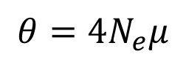
Measuring Genetic Diversity
$$θ=4N_{e}μ$$
Watterson’s Theta
Number of segregating sites
Theta Pi
Pairwise nucleotide diversity
vs
Segregating sites
Sample size
Notes:
There are many ways to measure genetic diversity that are all important for capturing a better understanding of a species’ genetic health. For the purpose of this talk we are interested in estimating the effective population size through the equation ( and I promise this is the only equation in my talk because my advisor has your back and I’ve deleted all the fun stuff. So, I’ll walk you through it!) We estimated the effective population size through the equation: Theta, that is the genetic diversity equals 4 times the effective population size (Ne) times the scaled per generation per base mutation rate (mew). Is everyone still with me? Okay we’ve made it through the equation.
We looked at two different measures of theta. The first is Watterson’s theta, which looks at the number of segregating (or variable) sites throughout an individuals genome. We would expect to see more variable sites by sampling more individuals & Watterson’s theta takes this into consideration by correcting for sample size.
The second theta estimator we looked into is theta pi or the average pairwise nucleotide diversity between two sequences. Here we have two different gene copies (this one up top with two mutations and the one on the bottom with three mutations) and we compare the average number of differences between these two sequences. We can use these statistics to estimate the effective population size of Delta Smelt by rearranging the above equation. Which you can do on your programs if you’re so inclined.

Slide 8


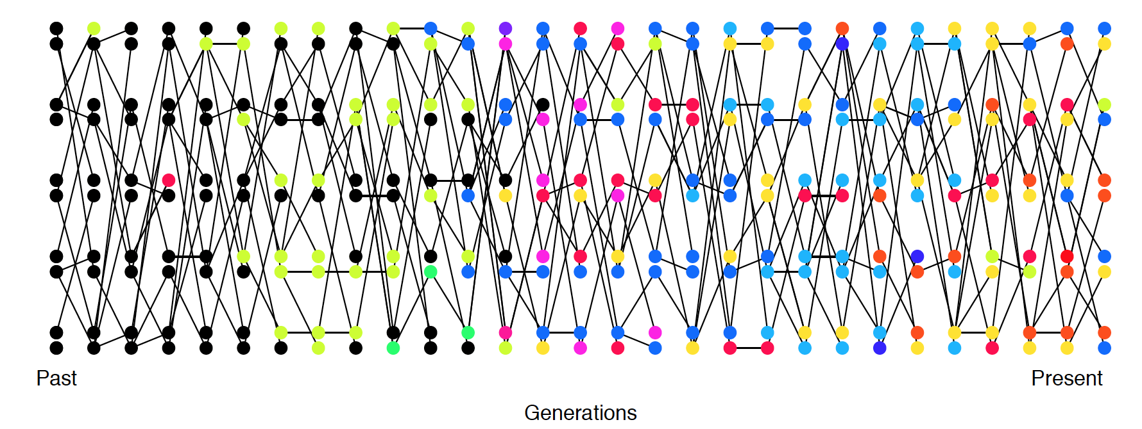
Effective Population Size (Ne)
mutation!
gene
flow!
Past
Present
Mutation and gene flow increase genetic diversity.
Figure: Coop 2017
Notes:
To gain a more intuitive understanding of what the effective population size of a species is here we have a plot of alleles through time. You can see on the left, in the past, the population is all black alleles––that is there’s no genetic variation at this allele. In time we can see outside green and blue populations or species mating with our species of interest introducing new alleles through gene flow.
Additionally or we can see that mutation can also increase variation in a species where the spontaneous mutation of black into yellow seen here leaves the population with many yellow alleles in the present day.
Alleles introduced through gene flow and mutation may slowly and randomly rise in frequency through genetic drift. We can see both yellow, green blue and many more colored alleles in the present day, on the right, due to these processes acting to create genetic diversity by adding new alleles to the population through time.

Slide 9
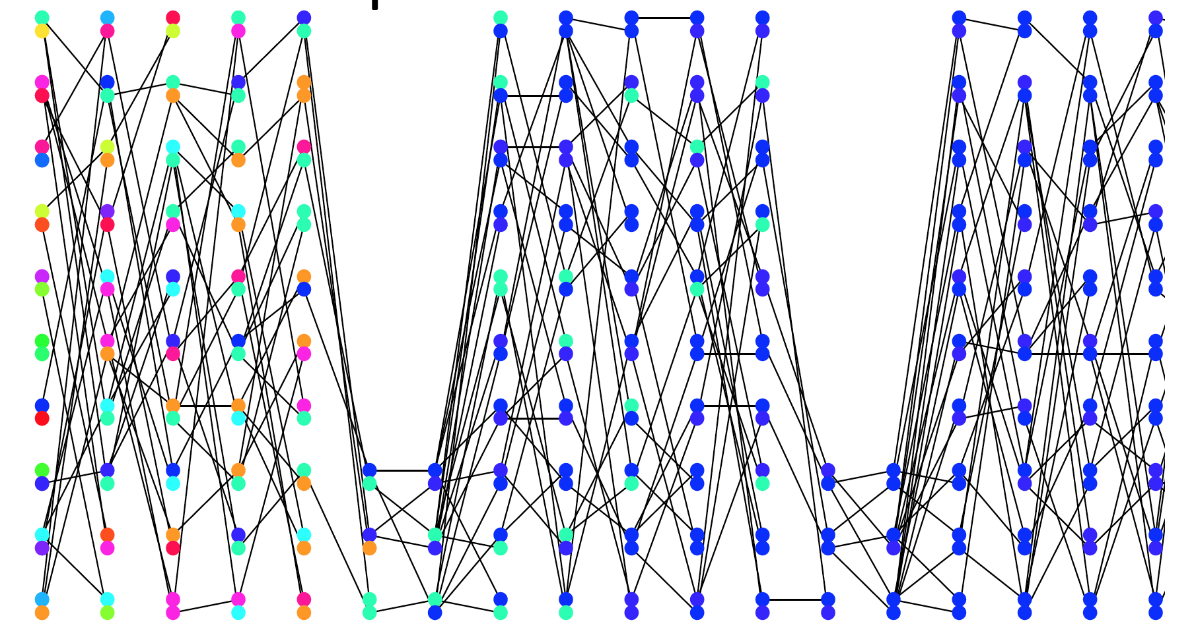
Demographic processes can act to decrease diversity
Past
Present
Figure: Coop 2017
Notes:
However, for every good there is an equal and opposite bad. Demographic processes can act to decrease genetic diversity through time. Here we have a diverse initial population that goes through two fairly significant bottlenecks. These vast reductions in population size decrease the number of different alleles in the following generations. By the second bottleneck there is no genetic variation at this location in the genome.

Slide 10
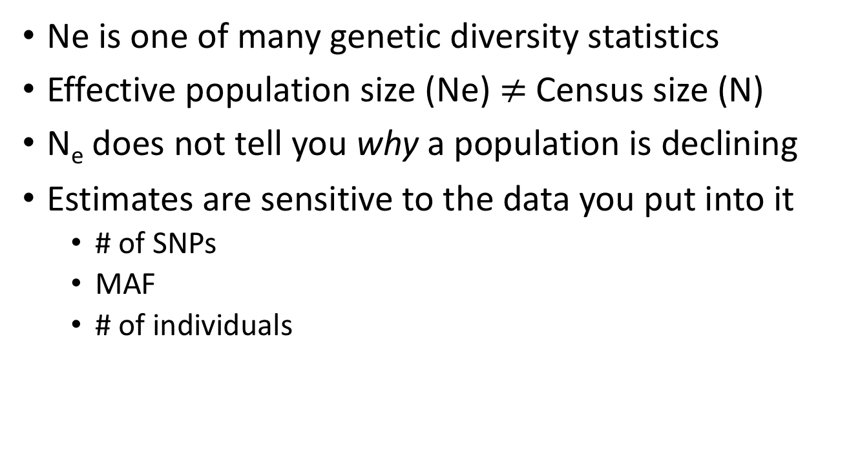
Limitations of Effective Population Size
Ne is one of many genetic diversity statistics
Effective population size (Ne) $≠$ Census size (N)
N_{e} does not tell you why a population is declining
Estimates are sensitive to the data you put into it
# of SNPs
MAF
# of individuals
Notes:
Before I get into the details of estimating Ne let me warn you that this is just a parameter.
It is not a census size. Oftentimes Ne is much much smaller than the census size. However, this can change when populations are in flux especially when they are rapidly decreasing
Additionally, the effective population size doesn’t tell you why a population is declining.
And the age old saying “garbage in gets garbage out”, so estimates of the effective population size are affected by not only by the number of polymorphic loci you put in, the frequency at which the alleles exist within a population and the samples size. If any of these are skewed it will throw off the accuracy of any and all following analyses.

Slide 11
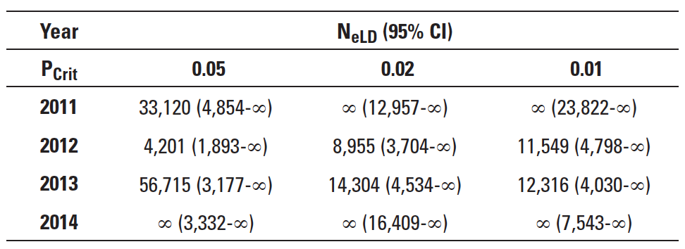
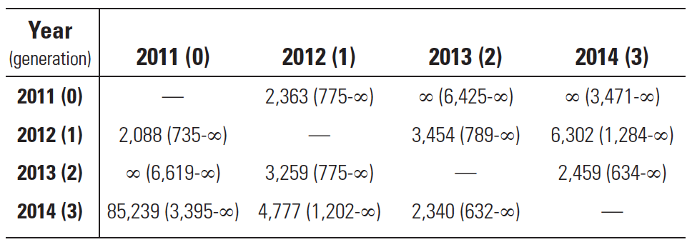
Previous estimates Ne
12-15 microsatellites | 4-8 generations
N_{eV}
Fisch et al. Conserv. Gen. 2011
Finger et al. San Fran. Est. Wat. Sci. 2017
Notes:
Previous estimates of effective population size in Delta Smelt have shown variable results. Fisch et al used 15 microsatellites and eight generations to estimate the effective population size of delta smelt and found that the effective population size was indeed decreasing from 2003 to 2009. However, Finger et al in 2018 used updated techniques and found that the effective population size of Delta Smelt couldn’t be accurately estimated from 2011 to 2014 when they used 12 microsatellites across 4 generations. This could be due to a number of reasons: the effective population size could indeed be exceedingly large or it could result from an insufficient amount of input of data for these fish.

Slide 12


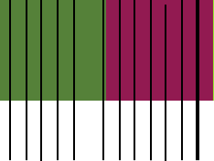
Harnessing the power of NGS
Microsatellite (previous work) – samples 12-15 sites throughout the genome
marker
linkage group
Linkage
Group 1
Linkage
Group 2
Restriction site associated sequencing (current work) – samples thousands of loci genome-wide
Notes:
Previous work by Lew et al found that the Delta Smelt genome has 26 distinct linkage groups. The previous methods’ microsatellite work surveys roughly once every other linkage group, so by using these methods we may be failing to gather informative loci that will allow estimates of the effective population size of delta smelt to be more accurate and precise.
My work harnesses the massive amount of data captured from next generation sequencing methods. Restriction site associated sequencing captures hundreds of thousands of locations throughout the genome––providing many, many more informative loci and surveying each linkage group throughout the genome multiple hundreds of times.

Slide 13
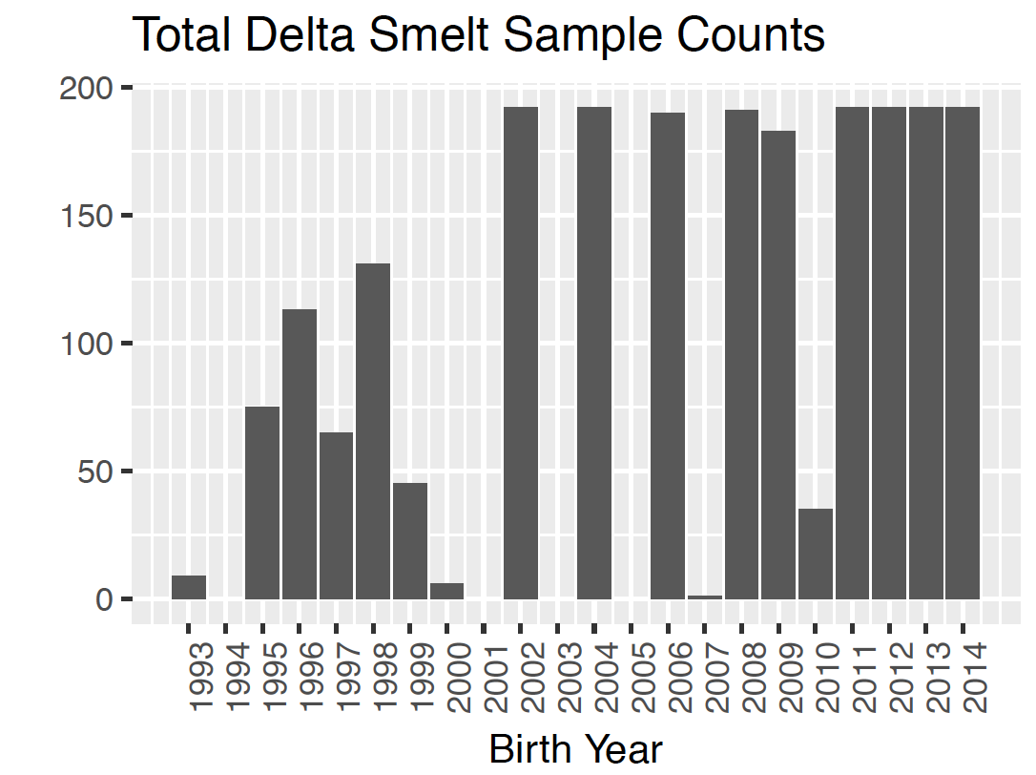

Increase Sample Size
Birth Year | Samples | Birth Year | Samples
1993 | 9 | 2005 | 0
1994 | 0 | 2006 | 190
1995 | 75 | 2007 | 1
1996 | 113 | 2008 | 191
1997 | 65 | 2009 | 183
1998 | 131 | 2010 | 35
1999 | 45 | 2011 | 192
2000 | 6 | 2012 | 192
2001 | 0 | 2013 | 192
2002 | 192 | 2014 | 192
2003 | 0 | 2015 | 108
2004 | 192 | 2016 | 84
2015
2016
Notes:
Additionally, another way we are increasing the accuracy and precision of estimating the effective population size of delta smelt is though increasing the number of individuals and generations we are using in our estimates. We’ve sequenced over 2,400 fish spanning 24 generations, identifying hundreds of thousands of loci throughout the genome.

Slide 14
Genomic Variation is Decreasing
Notes:
We can see a slight decrease in variation through a principle component analysis with more recent years having less genomic variation than older years. You can see a broader distribution of the first and second principle components in the samples from the 90s versus a shrinking or tightening of the clusters of the years in the twenty-tens.

Slide 15
Long term Ne is decreasing
Effective Population Size of Delta Smelt 1995-2016
Notes:
As a note before I present this figure I will say this is preliminary and we still have some analyses to run on these data. But when we estimate the long-term effective population size of Delta Smelt we see an overall decrease from 1995 to 2016. Both Watterson’s theta and theta pi are systemically decreasing over the twenty 21 generations we estimated the effective population size for. Years 1999, 2000 and 2010 all have sample sizes that are much smaller than the rest of the time points. As I mentioned before this can skew estimations. However, the long-term effective population size for each year were independently estimated. So, what I’d like you to focus on is the overall decrease of the effective population size in delta smelt. Specifically in 2015 and 2016––the years Jim Hobbs mentioned were particularly hot and unfavorable––where both estimates appreciably drop off.

Slide 16
The Future
Investigate outlying years
Contemporary Ne
Sequence Delta Smelt genome to more accurately monitor genetic diversity
Incorporate into models to assist management
Photo: CA Dept. Water Resources
Notes:
So where do we go in the future? We will certainly be looking into the outlying years, and will be estimating contemporary Ne across all years. We will be sequencing the Delta Smelt genome in order to improve bioinformatic analyses, investigate selection, domestication and obtain the most precise and accurate estimation of the effective population size of delta smelt possible. Additionally, what we are not currently doing but I encourage others to think and I’d love to chat about is incorporating these kinds of data into genetic models for delta smelt.

Slide 17
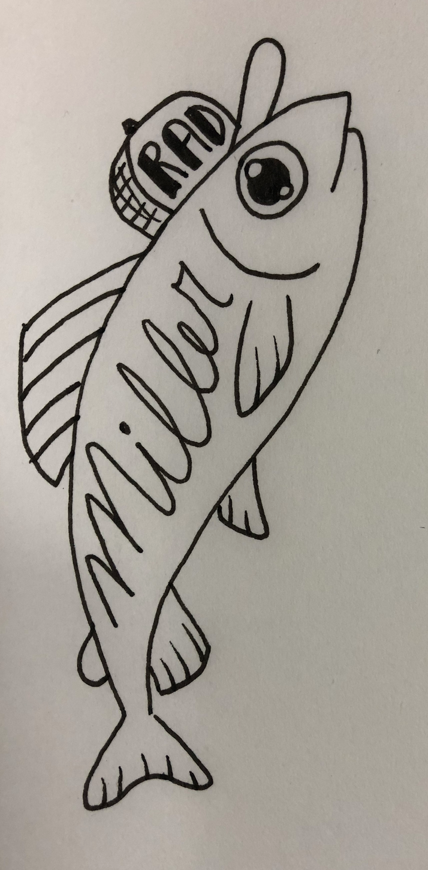

Thank you!
Contact: Shannon Joslin
sejoslin@ucdavis.edu
@IntrprtngGnmcs
Dept. Water Res.
Genomic Variation Lab
Miller Lab
Mandi Finger
Alisha Goodbla
Alyssa Benjamin
Ismail Saglam
Mike Miller
Andrea Schreier
Melinda Baerwald
Ted Sommers
Notes:
And with that I would like to thank my labs and my funding sources and everyone who contributed to this ongoing work.

